Slide 1
Building Infrastructure Classification and Detection
Course No.: CSE 4000
Presented By
Faisal Ahmed
Roll: 1607048
Md. Mahmudul Islam
Roll: 1607052
Supervised By
Dr. Sk. Md. Masudul Ahsan
Professor
Department of CSE, KUET

Slide 2
Outlines
Problem statement
Related works
Objectives
Methodology
Progress
Conclusion
References

Slide 3
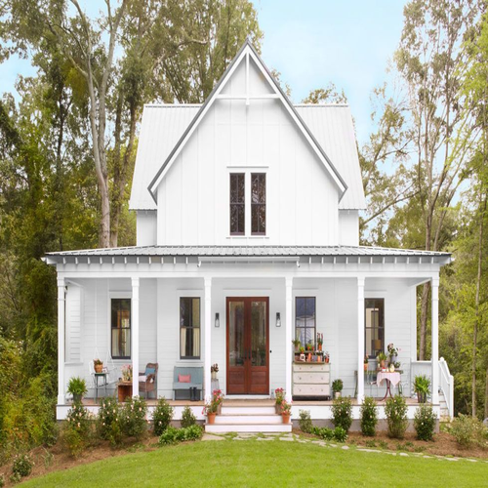
Problem Statement
Automated building infrastructure detection for intelligence system
Classify different types of building structure
Automated real estate image classification

Slide 4
Related work
Bappy et al. proposed a method to classify real estate image using CNN and LSTM.
Kitchen, bedroom, front yard images classification
Pouraseed et all. proposed a vision based real estate price estimation
Category luxury level 1 to 8
Vakalopulou et al. proposed a building detection technique from aerial view using deep learning features
Ayesha et al. proposed a real time object detection using pre-trained deep learning models MobileNet-SSD

Slide 5
Objective
Developed an architecture for image classification
Collect different types of building image to make a dataset
Find a region of interest to localize the building
Developed an architecture for object detection
Develop a web based application

Slide 6


Proposed Method
Start
Create image
dataset
Pre processing
Create CNN model
Building classification
Find region of interest
Input: Building image
Output: Building House
End
Notes:
Sell House Fast Little Rock - Google Search

Slide 7
Image Datasets
Datasets collection using smartphone camera and internet
Datasets divided into four categories are building house, mosque, temple, tin shed, sky building, matir ghor
Split all the image into train set, test set
Dataset contains approximately 1500 images

Slide 8
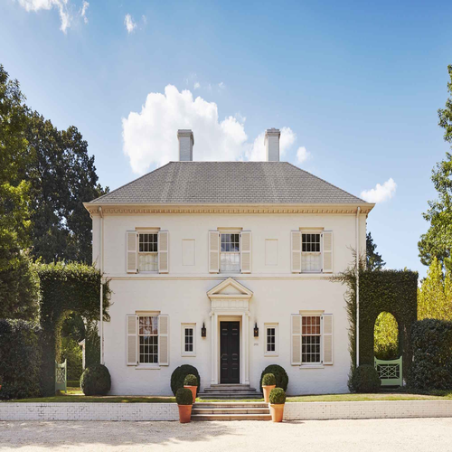


Image Datasets
1) Building house
2) Mosque
Notes:
Google Search

Slide 9
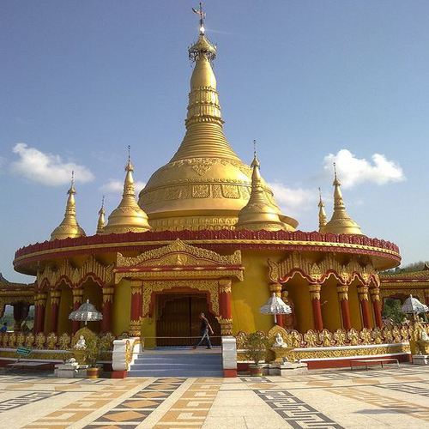
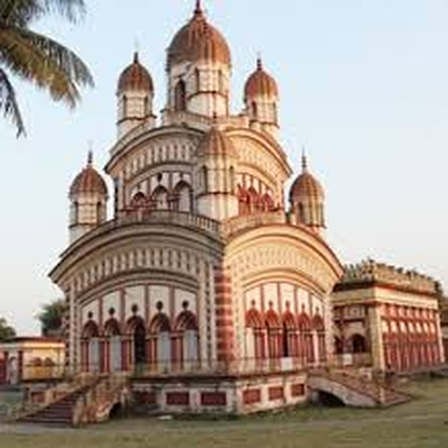
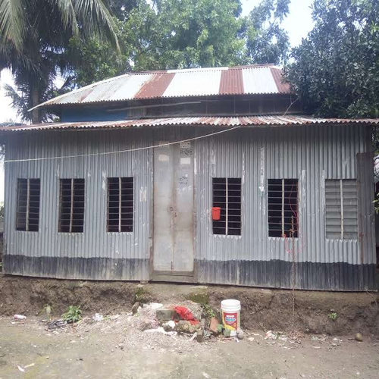
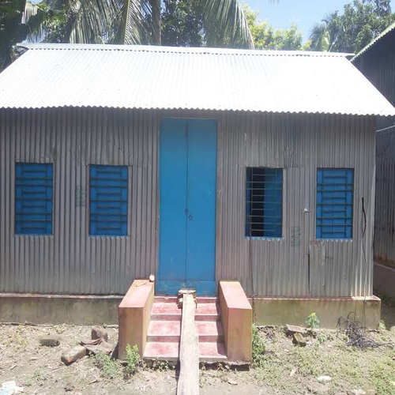
Image Datasets
3) Temple
4) Tin shed
Notes:
Google Search

Slide 10
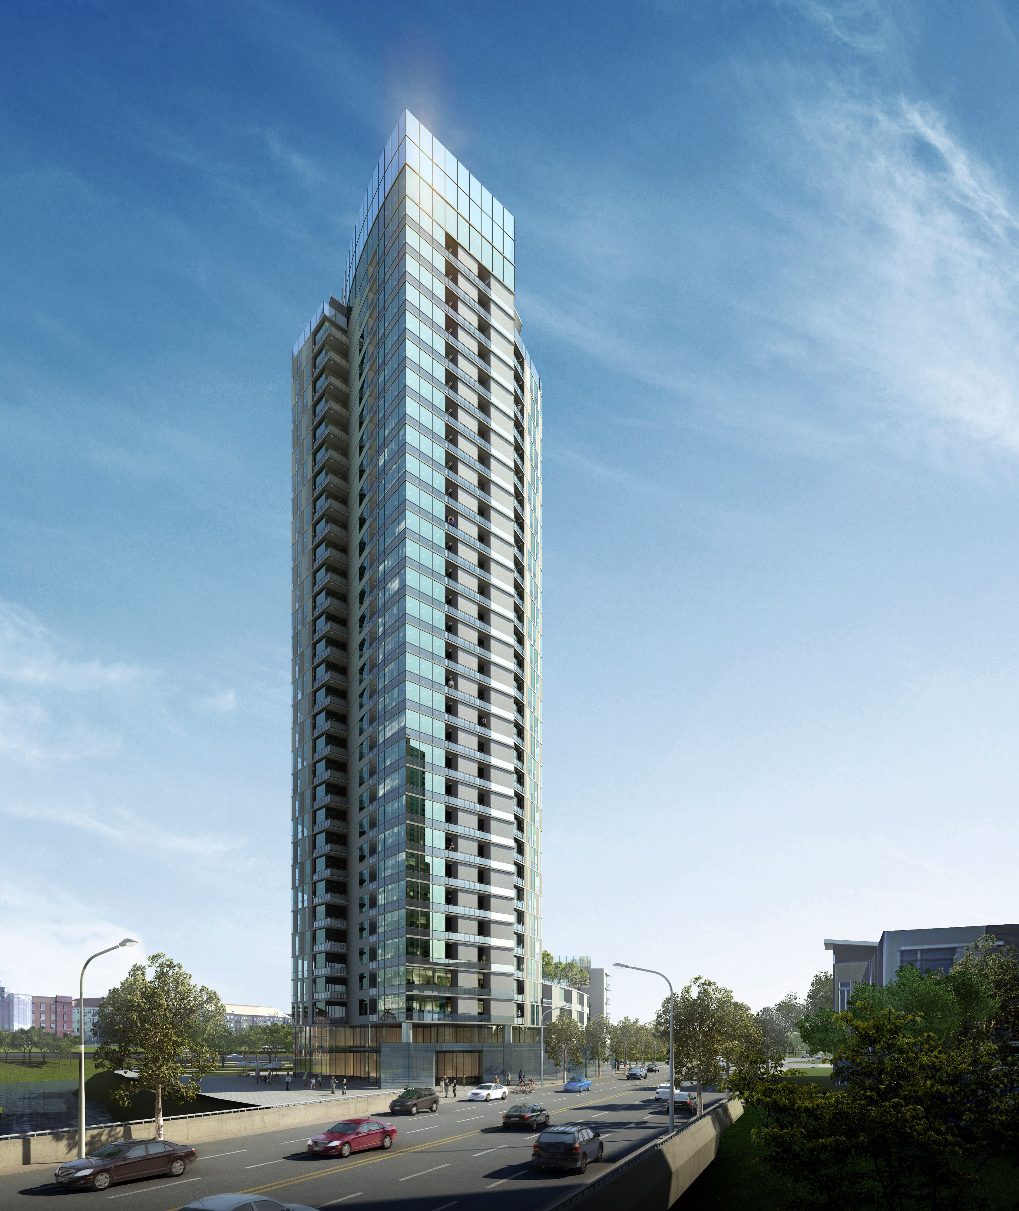
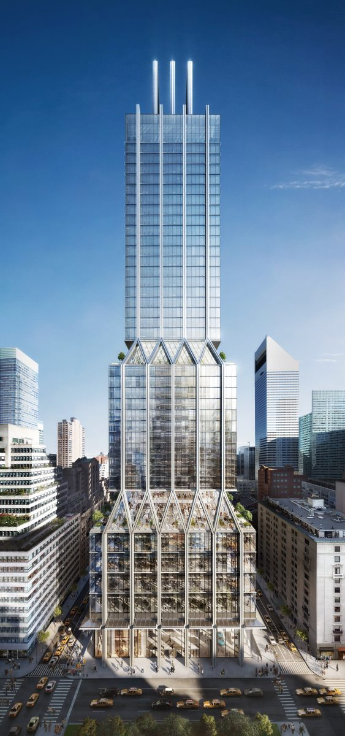
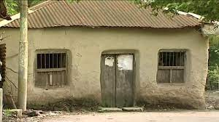
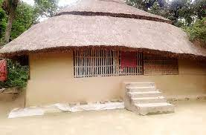
Image Datasets
5) Sky Building
6) Matir Ghor
Notes:
Google Search

Slide 11


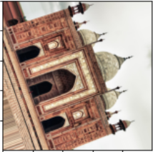
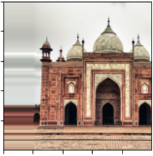
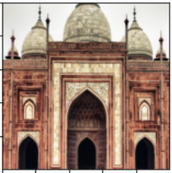
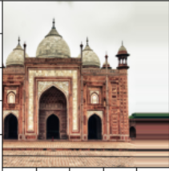
Data augmentation
Input image
Height shift
Rotation
Right shift
Zoom
Left shift

Slide 12
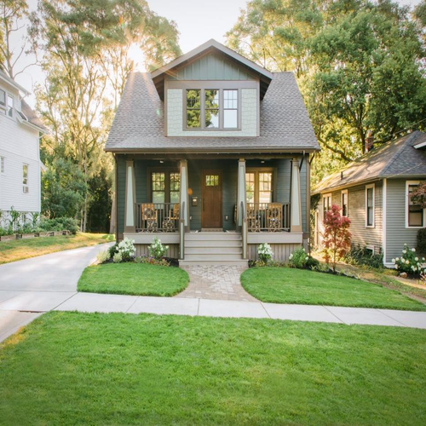
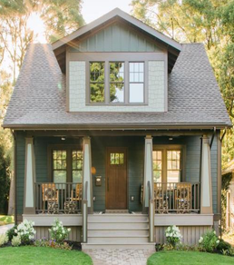
Image preprocessing
Resize image shape into 224x224 pixels
Rotate image manually if required
Crop the image manually if required
Input image
Cropped image

Slide 13
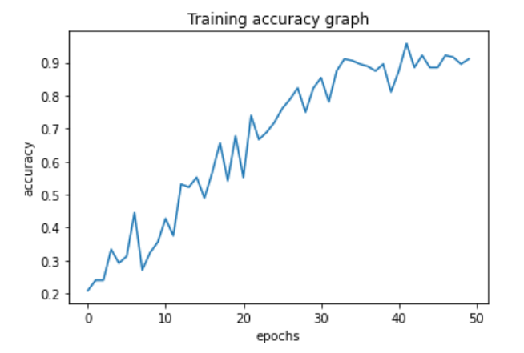
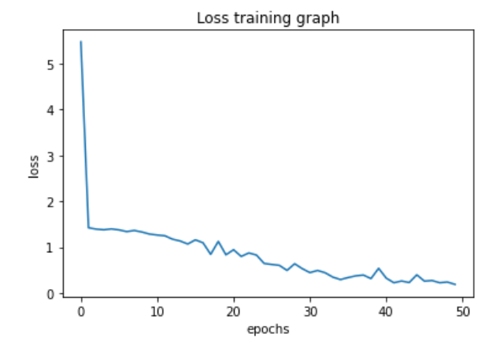
Image Classification: CNN
Convolutional neural network are used for image classification and recognition because of higher accuracy .
Model accuracy 93.63 %
Start
Data augmentation
Define model architecture
Train model
Evaluate model using test set
Plot accuracy and loss graph
Training accuracy graph
Training loss graph
End

Slide 14
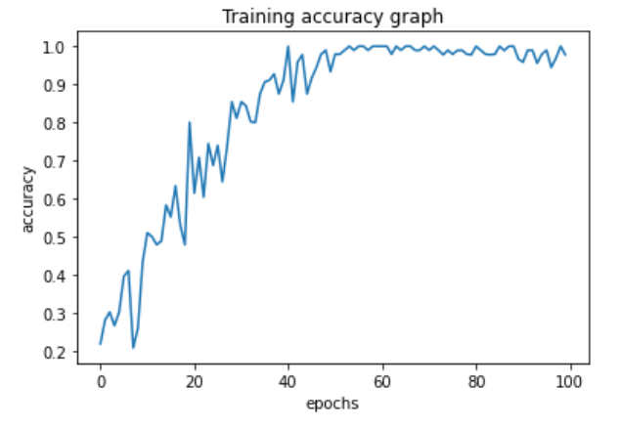
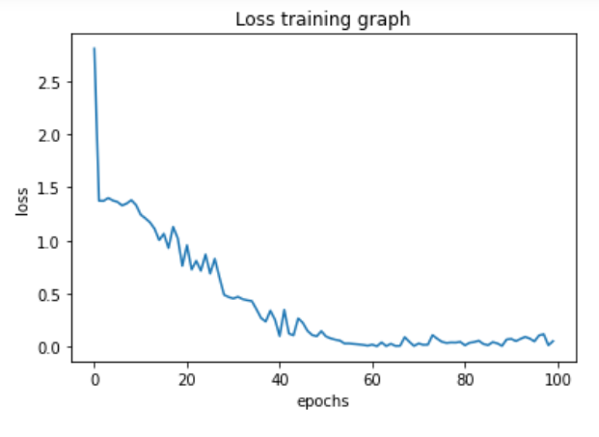
Image classification: CNN
Model accuracy 99%
Epoch 100
Training accuracy graph
Training loss graph

Slide 15
Image classification : CNN
Steps
Datasets divided into train set, validation set and test set
Data augmentation using ImageDataGenerator
Define a deep convolutional neural network architecture for classification purpose
Train the model using train set and validation set
Calculate the accuracy of the model using test set
Plot accuracy graph, loss graph

Slide 16
Convolutional neural network architecture
Convolution 3
f=128, k=3x3
Dense 1
L=512
Max pool 3
p=2x2
Dropout 2
0.5
Convolution 1
f=32, k =3x3
Convolution 4
f=128, k=3x3
Dense 2
L=4
Max pool 1
p=2x2
Max pool 4
p=2x2
Class probability
Convolution 2
f=64,k=3x3
Dropout 1
0.2
Filters=f
Kernel size=k
Pool size=p
Dense Layer=L
Max pool 2
p=2x2
Flatten 1
Notes:
Filters=f
Kernel size=k
Pool size=p
Dense Layer=L

Slide 17


Convolutional Filters Visualization
Input Image
Convolutional Filter 1
Convolutional Filter 2

Slide 18
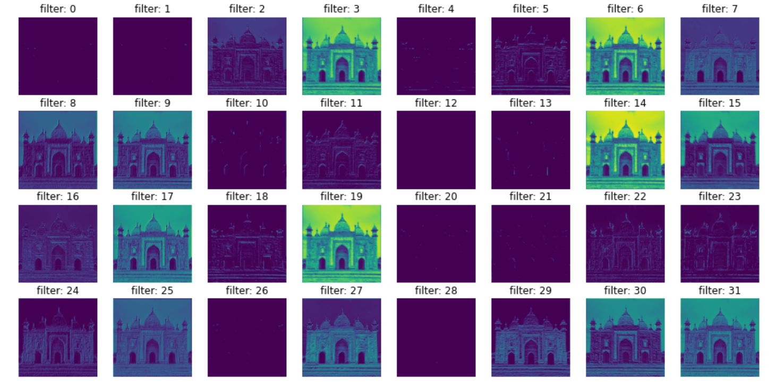
Convolutional Filters Visualization

Slide 19
Model parameter
Loss: Categorial cross entropy
Optimizer: Adam
Epochs: 50
Steps per epochs: 3
Batch size: 32

Slide 20
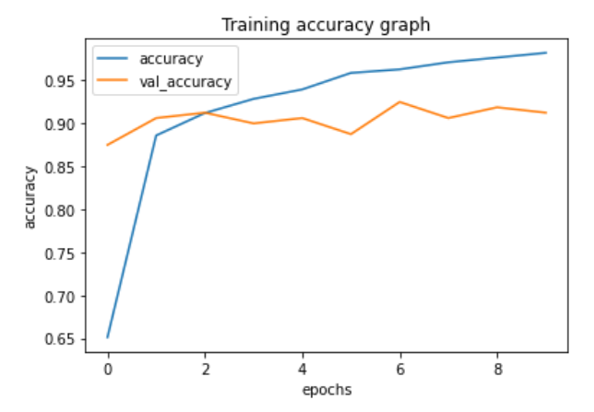
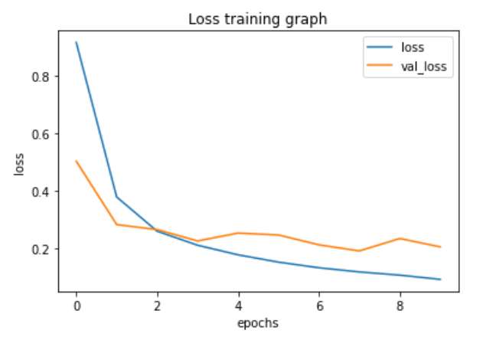
Image Classification: Mobile Net
Mobile Net is a transfer learning architecture that uses depth wise separable convolution to build light weight deep neural networks.
Model accuracy in train set: 98%
Model accuracy in test set: 90 %

Slide 21
Mobile Net Overview
MobileNet is small, low latency, lower power models to meet the resource constraints of a variety of use cases.
MobileNet is faster than the others popular transfer learning model
MobileNet is trained on ImageNet dataset
Model | Year | Size | Accuracy (Top 5) | Parameters
VGG-16 | 2015 | 528 MB | 0.901 | 138,357,544
ResNet-50 | 2015 | 98 MB | 0.921 | 25,636,712
Inception V3 | 2016 | 92 MB | 0.937 | 23,851,784
Xception | 2017 | 88 MB | 0.945 | 22,910,480
MobileNet V2 | 2018 | 14 MB | 0.901 | 3,538,984
Notes:
https://ai.googleblog.com/2018/04/mobilenetv2-next-generation-of-on.html
https://keras.io/api/applications/

Slide 22
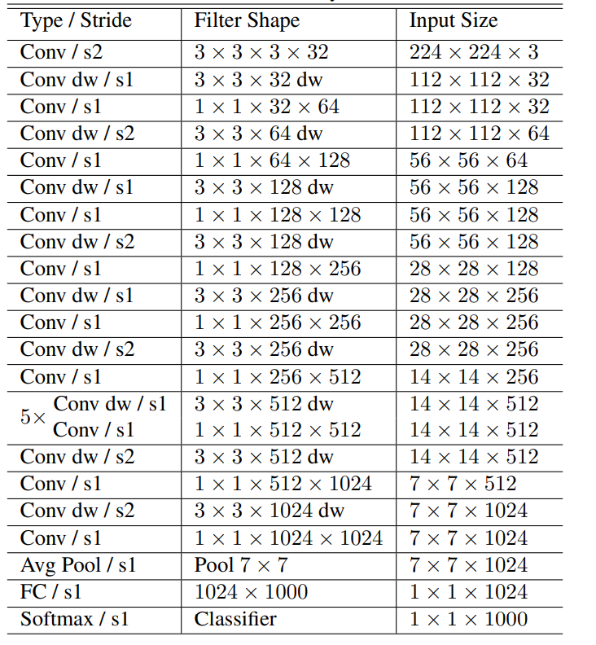
Mobile Net Architecture
Developed by Google
Required less training time
Total layers: 28
Notes:
https://ai.googleblog.com/2018/04/mobilenetv2-next-generation-of-on.html

Slide 23
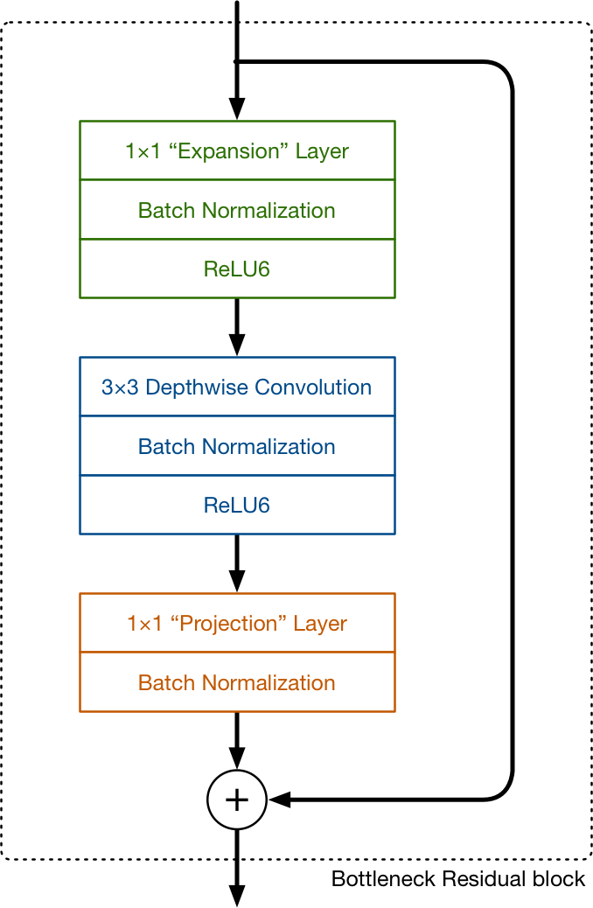
MobileNet V2 Convolutional Block

Slide 24
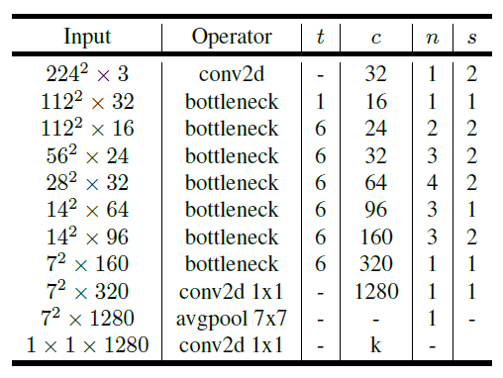
MobileNet V2 Architecture
Notes:
https://ai.googleblog.com/2018/04/mobilenetv2-next-generation-of-on.html

Slide 25
Object Detection and Localization
Annotating and labeling the image
Implement object detection using MobileNet and Single Shot Detector (SSD)
Draw bounding box into the image
Comparison between ground truth and predicted bounding box

Slide 26
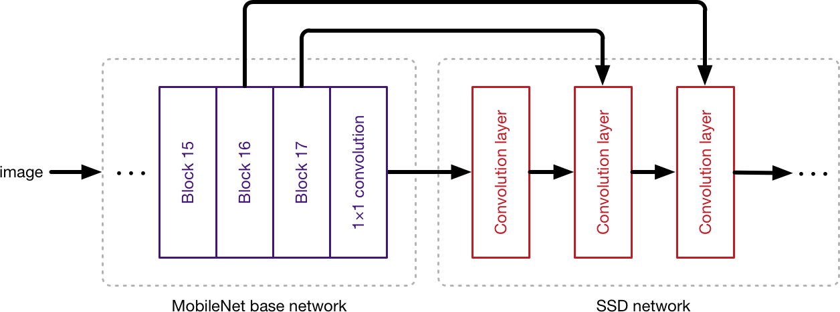
Object Detection: MobileNet + SSD
The job of the MobileNet layers is to convert the pixels from the input image into features that describe the contents of the image.
The SSD architecture is a single convolution network that learns to predict bounding box locations and classify these locations in one pass
using SSD, we only need to take one single shot to detect multiple objects within the image

Slide 27
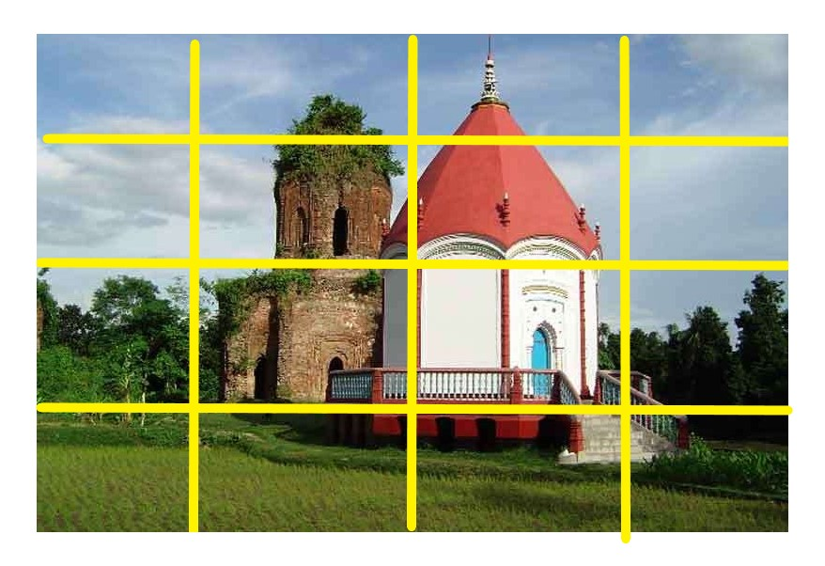
Object Detection Steps
Split the image into grid
Predicted output vector contains
Pc = Probability of object in a grid
X,Y = center of the box
W,H= height and width of box
C1,…,CN= classes
Output Vector =[Pc,X,Y,W,H,C1,…..,CN]
Image with 4x4 Grid

Slide 28
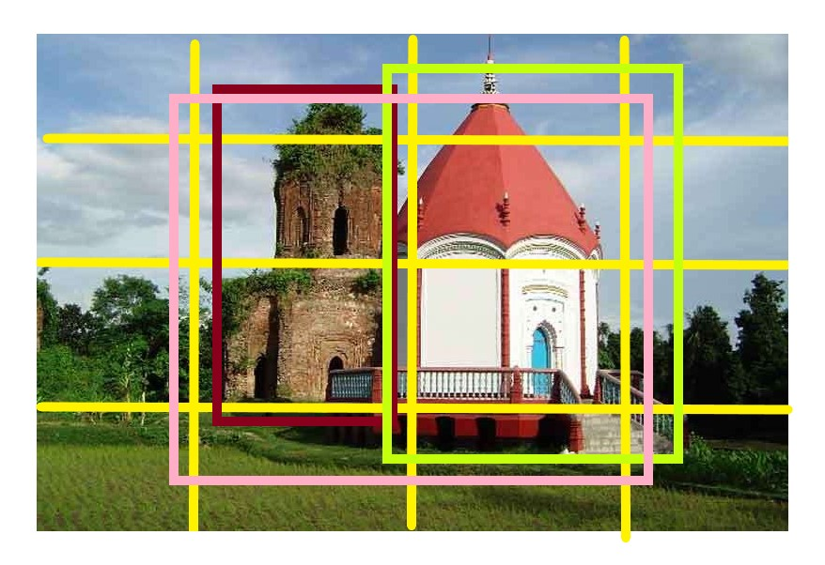
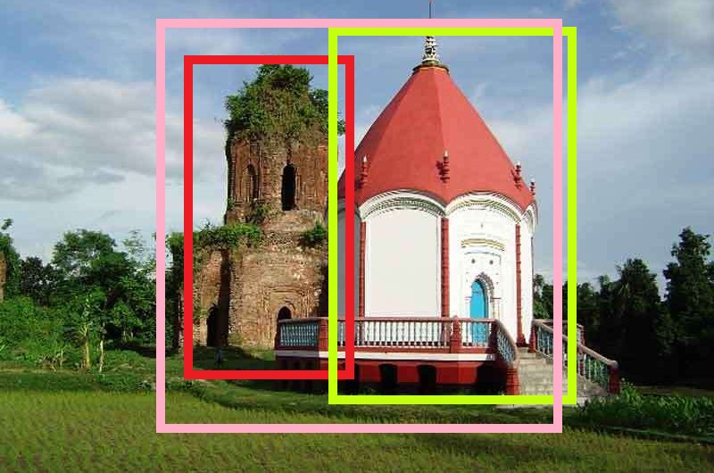
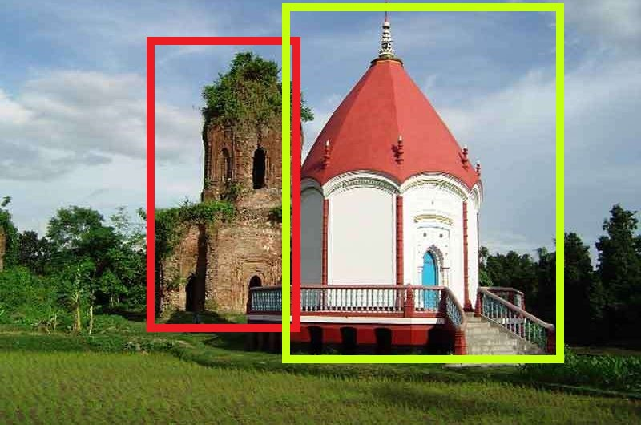
Object Detection Steps
Grid with bounding box
Predicted all bounding box
Apply non maximum
suppression

Slide 29
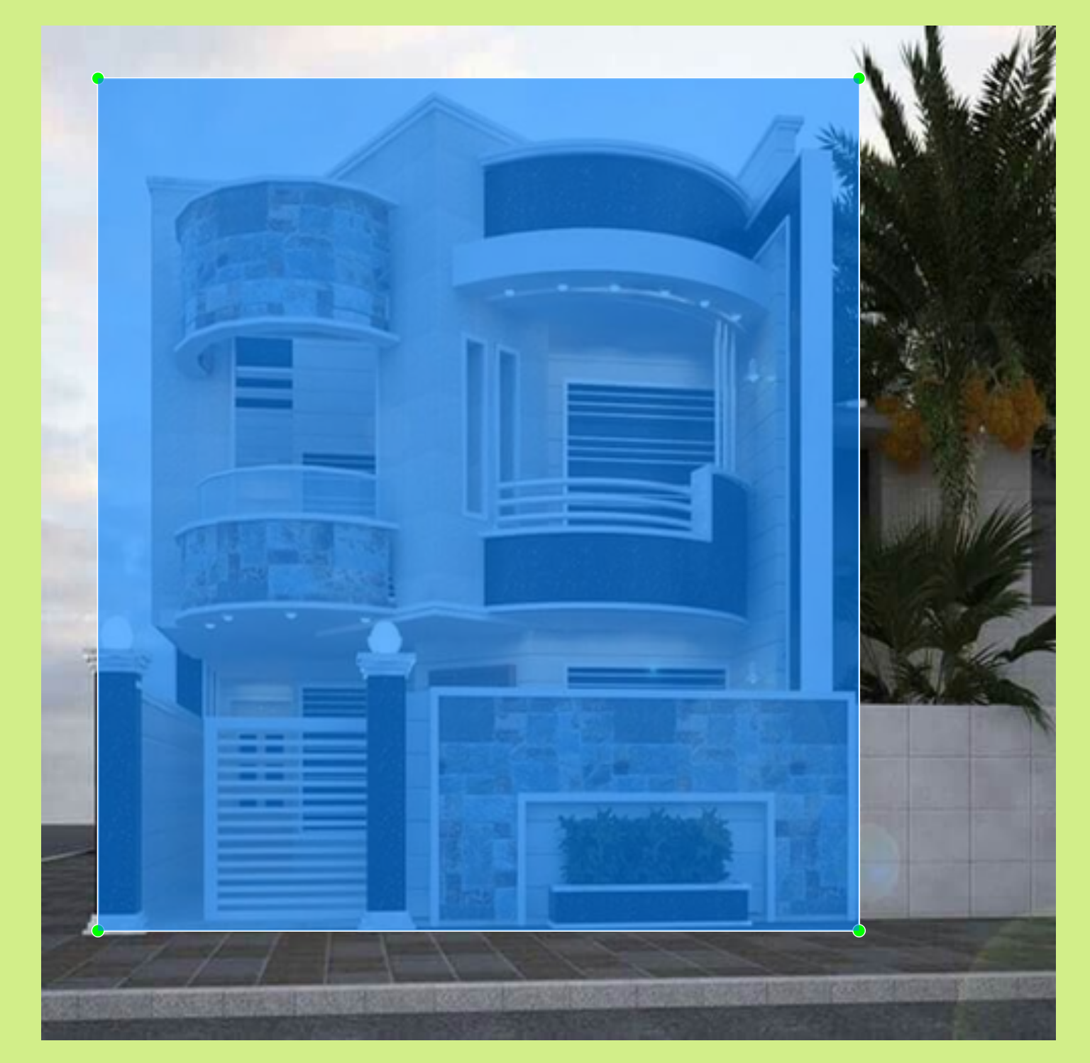
Image Labeling
Image labeling using labelImg.
Annotations are saved as XML files.
<annotation verified="yes">
<folder>allimages</folder>
<filename>building_house20.png</filename>
<path>/Users/Mahmud/Desktop/ML/CSE 4000 Thesis/RealTimeHomeDetection/workspace/images/allimages/building_house20.png</path>
<source>
<database>Unknown</database>
</source>
<size>
<width>500</width>
<height>500</height>
<depth>3</depth>
</size>
<segmented>0</segmented>
<object>
<name>Building House</name>
<pose>Unspecified</pose>
<truncated>0</truncated>
<difficult>0</difficult>
<bndbox>
<xmin>28</xmin>
<ymin>26</ymin>
<xmax>403</xmax>
<ymax>446</ymax>
</bndbox>
</object>
</annotation>
Image:
Annotation:

Slide 30
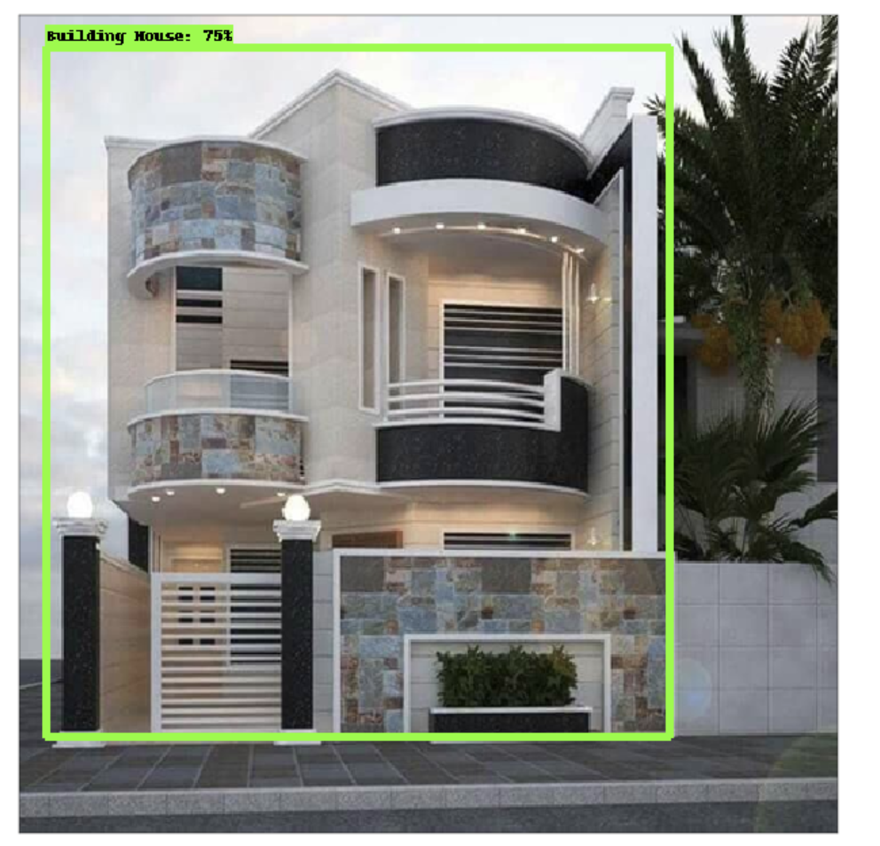
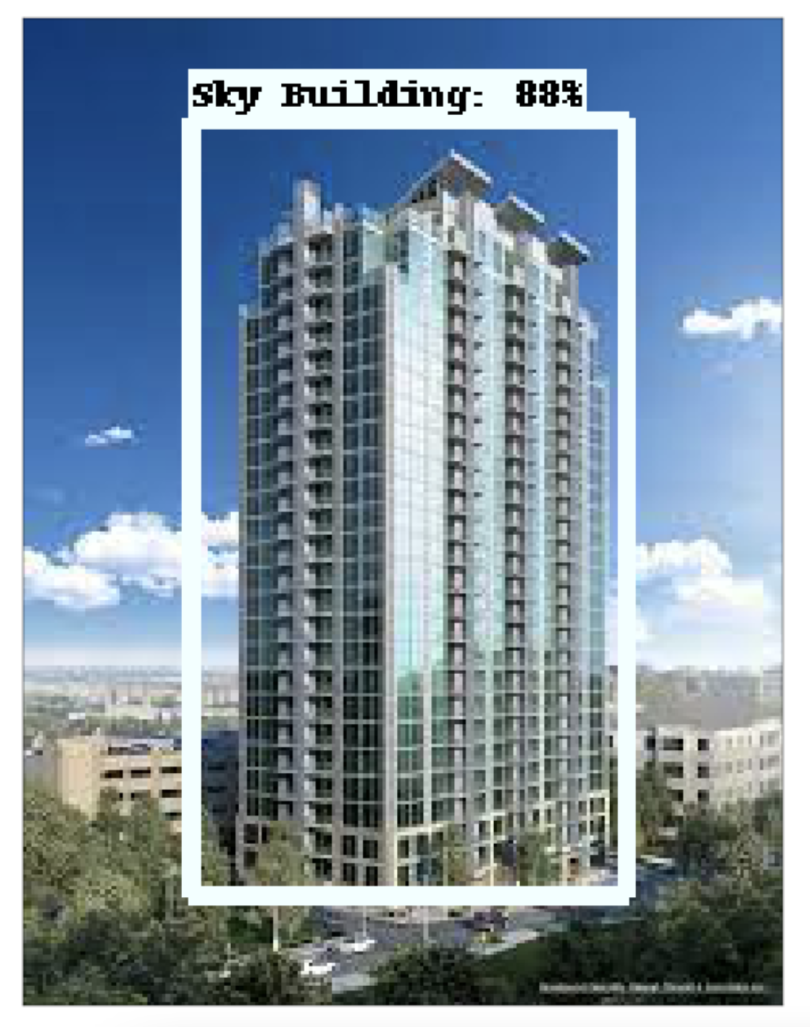
Object Detection
Building House
Sky Building

Slide 31
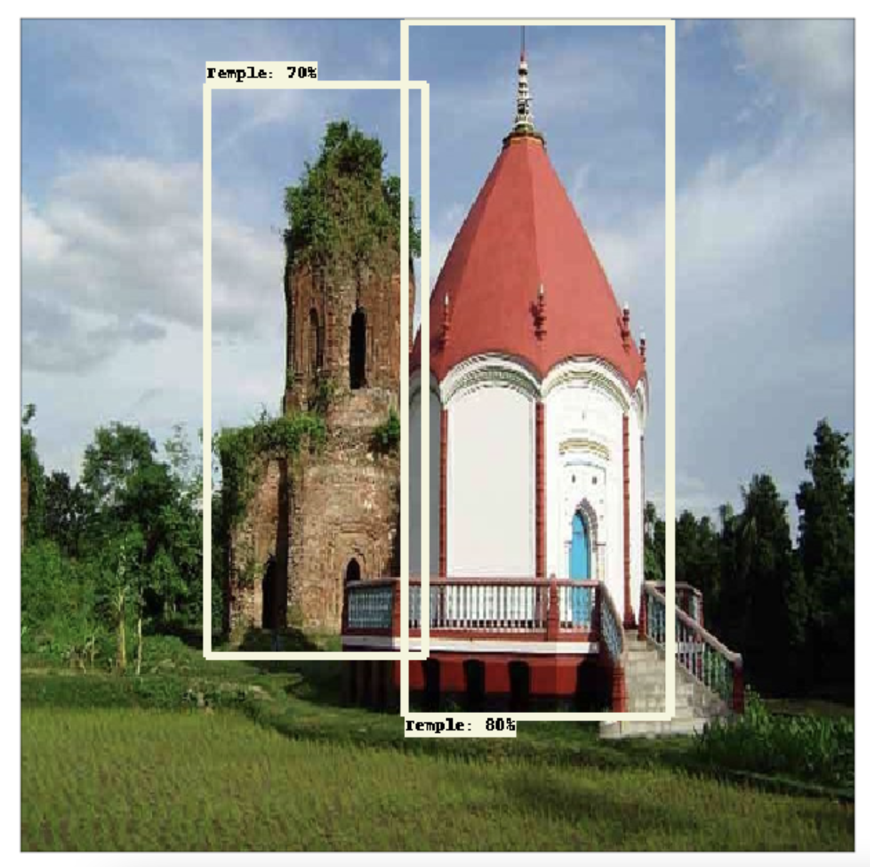
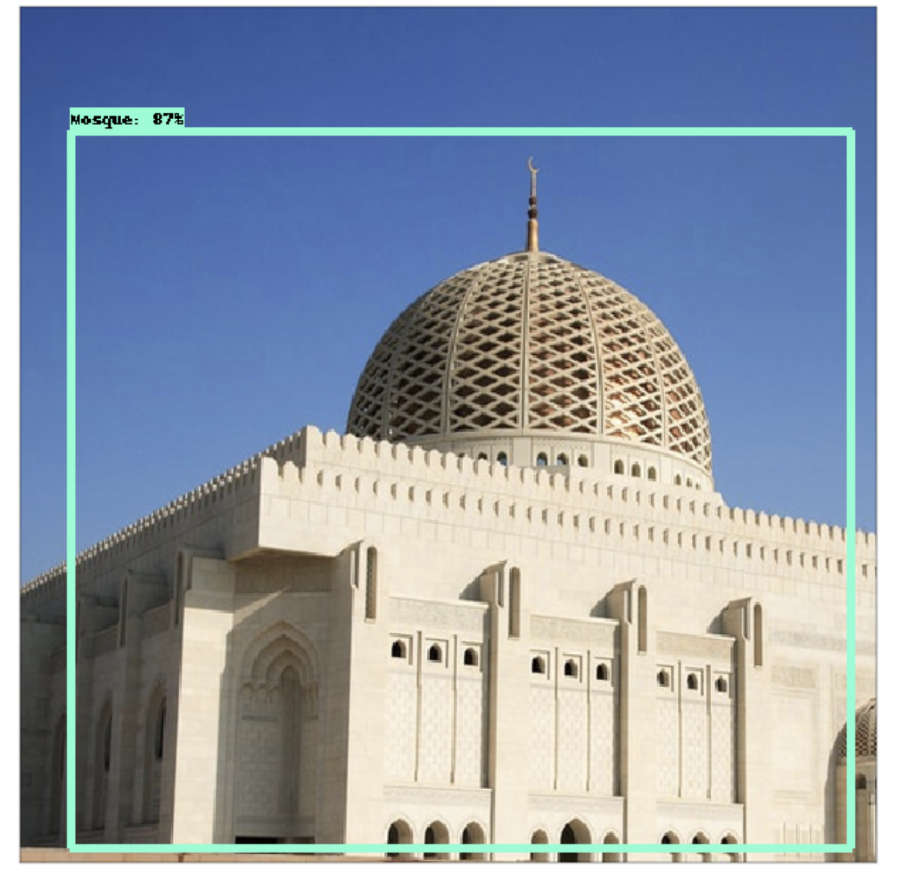
Object Detection
Temple
Mosque

Slide 32
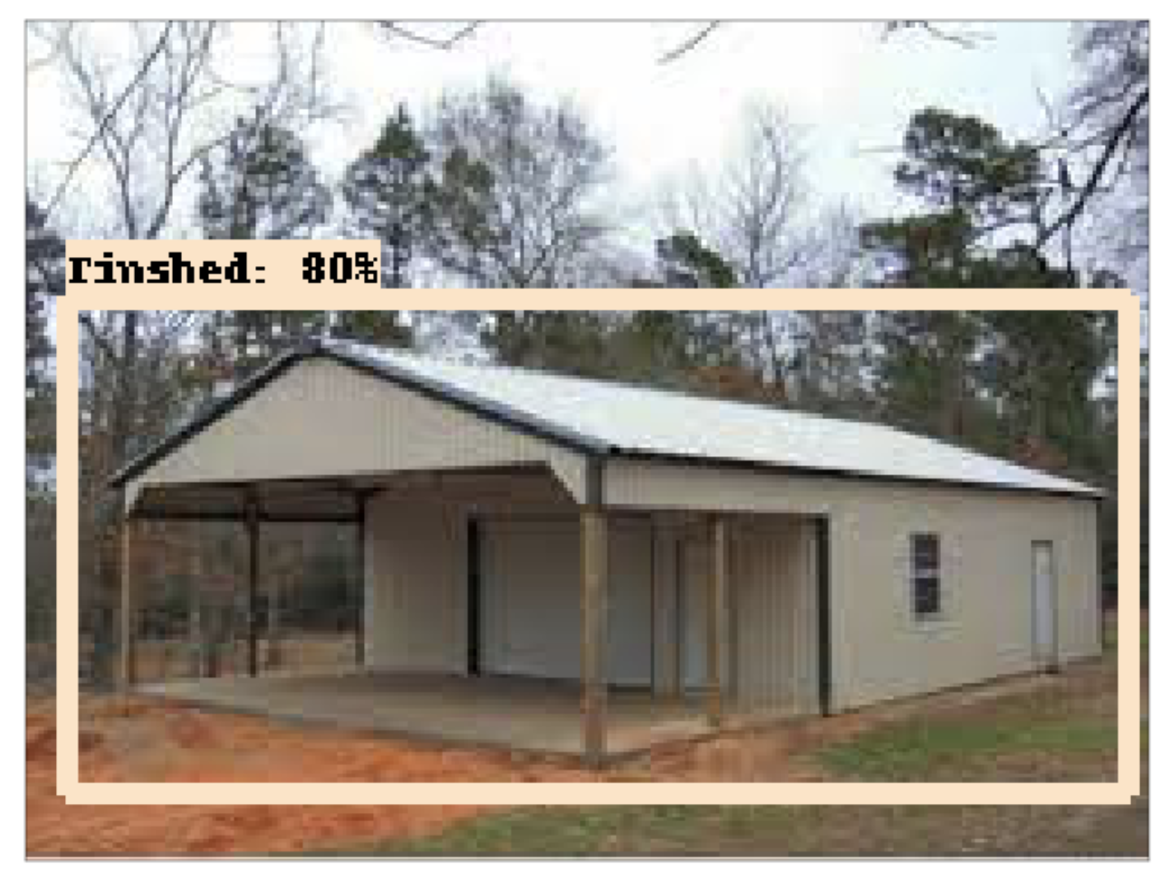
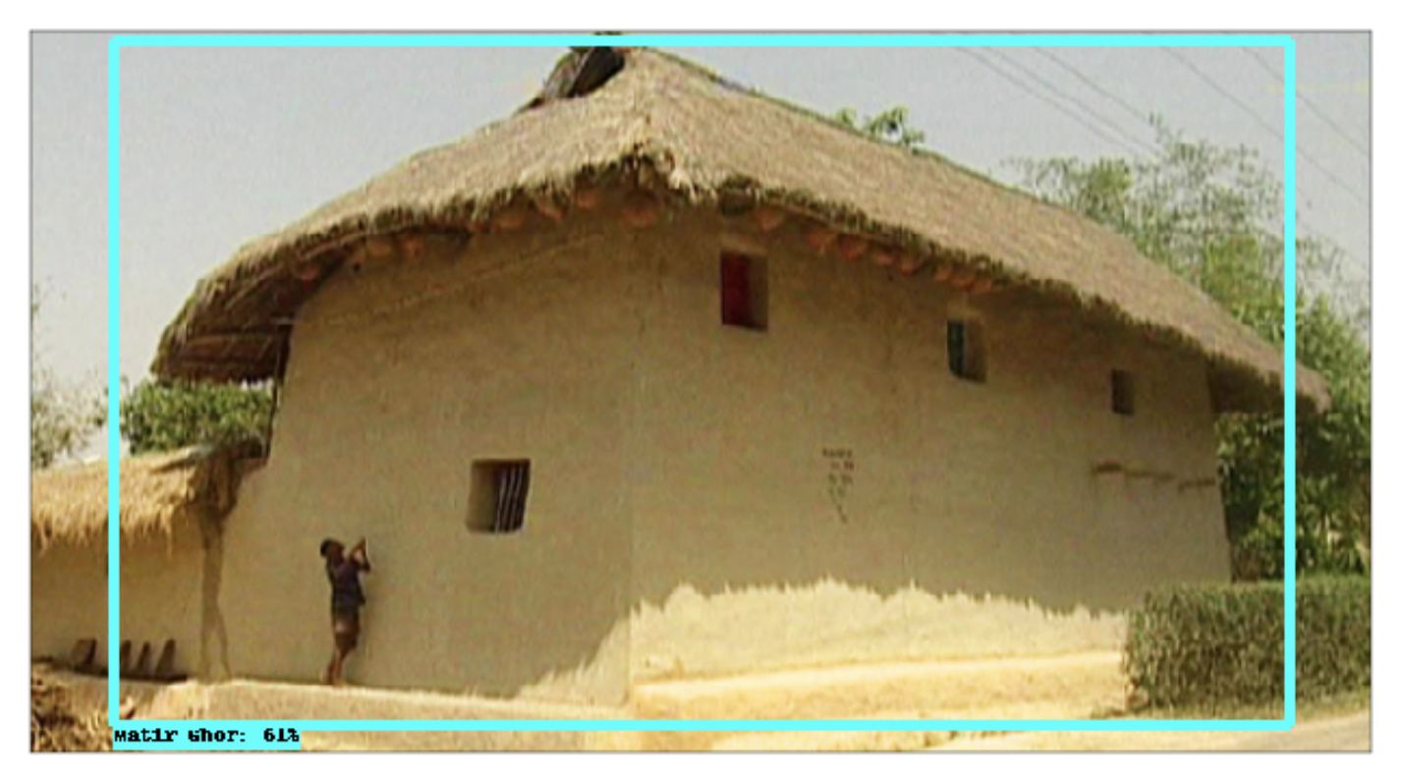
Object Detection
Tinshed
Matir Ghor

Slide 33
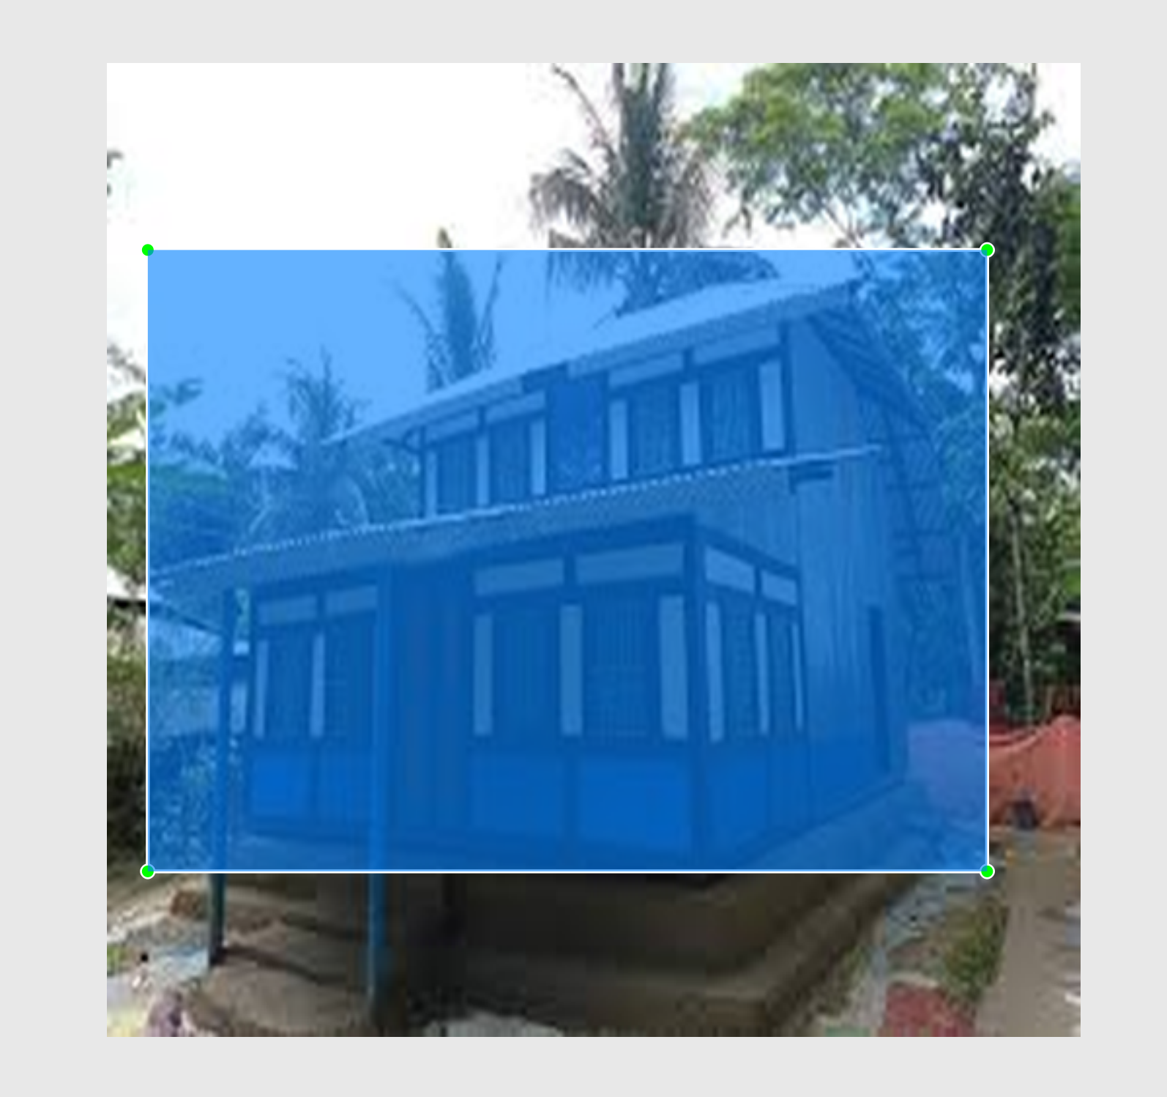
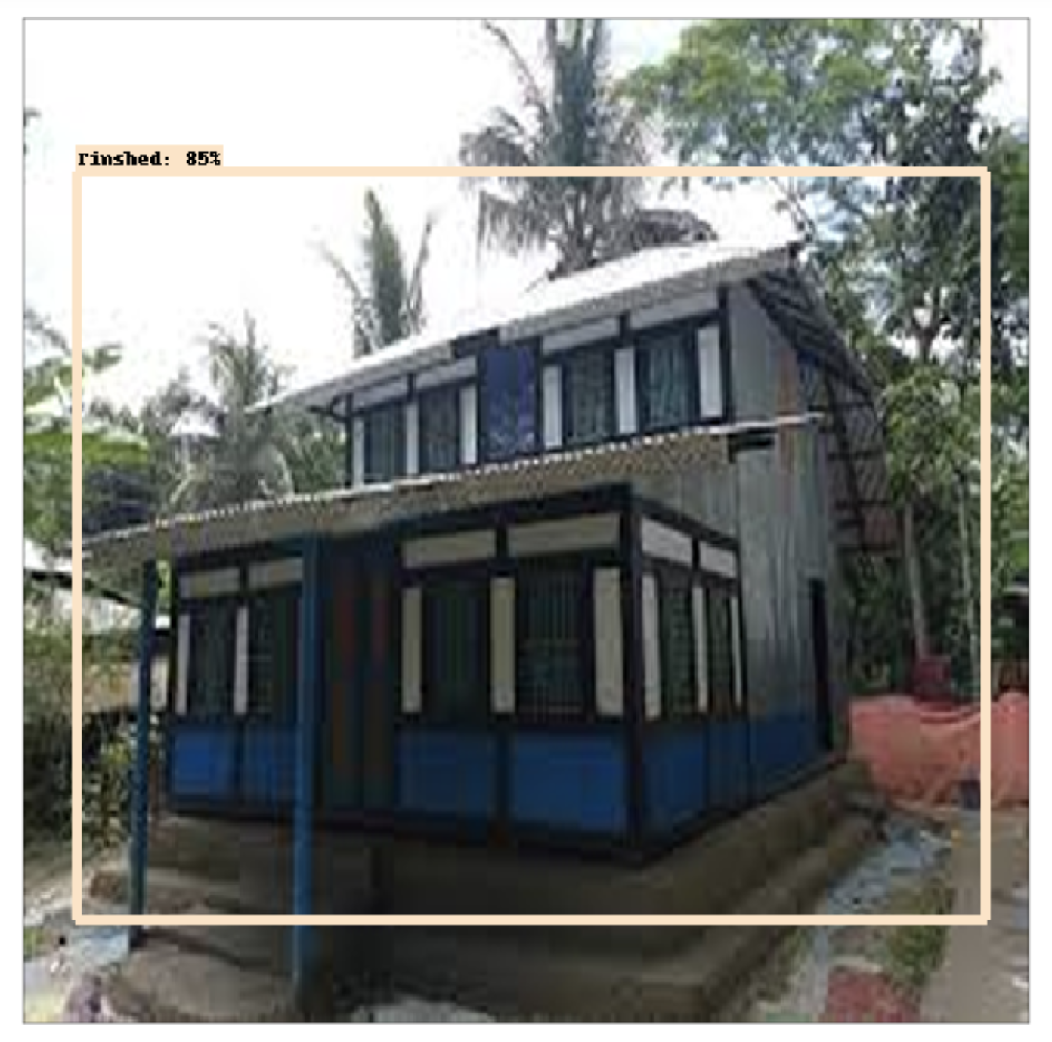
Detection Analysis
Ground Truth
Predicted bounding box

Slide 34
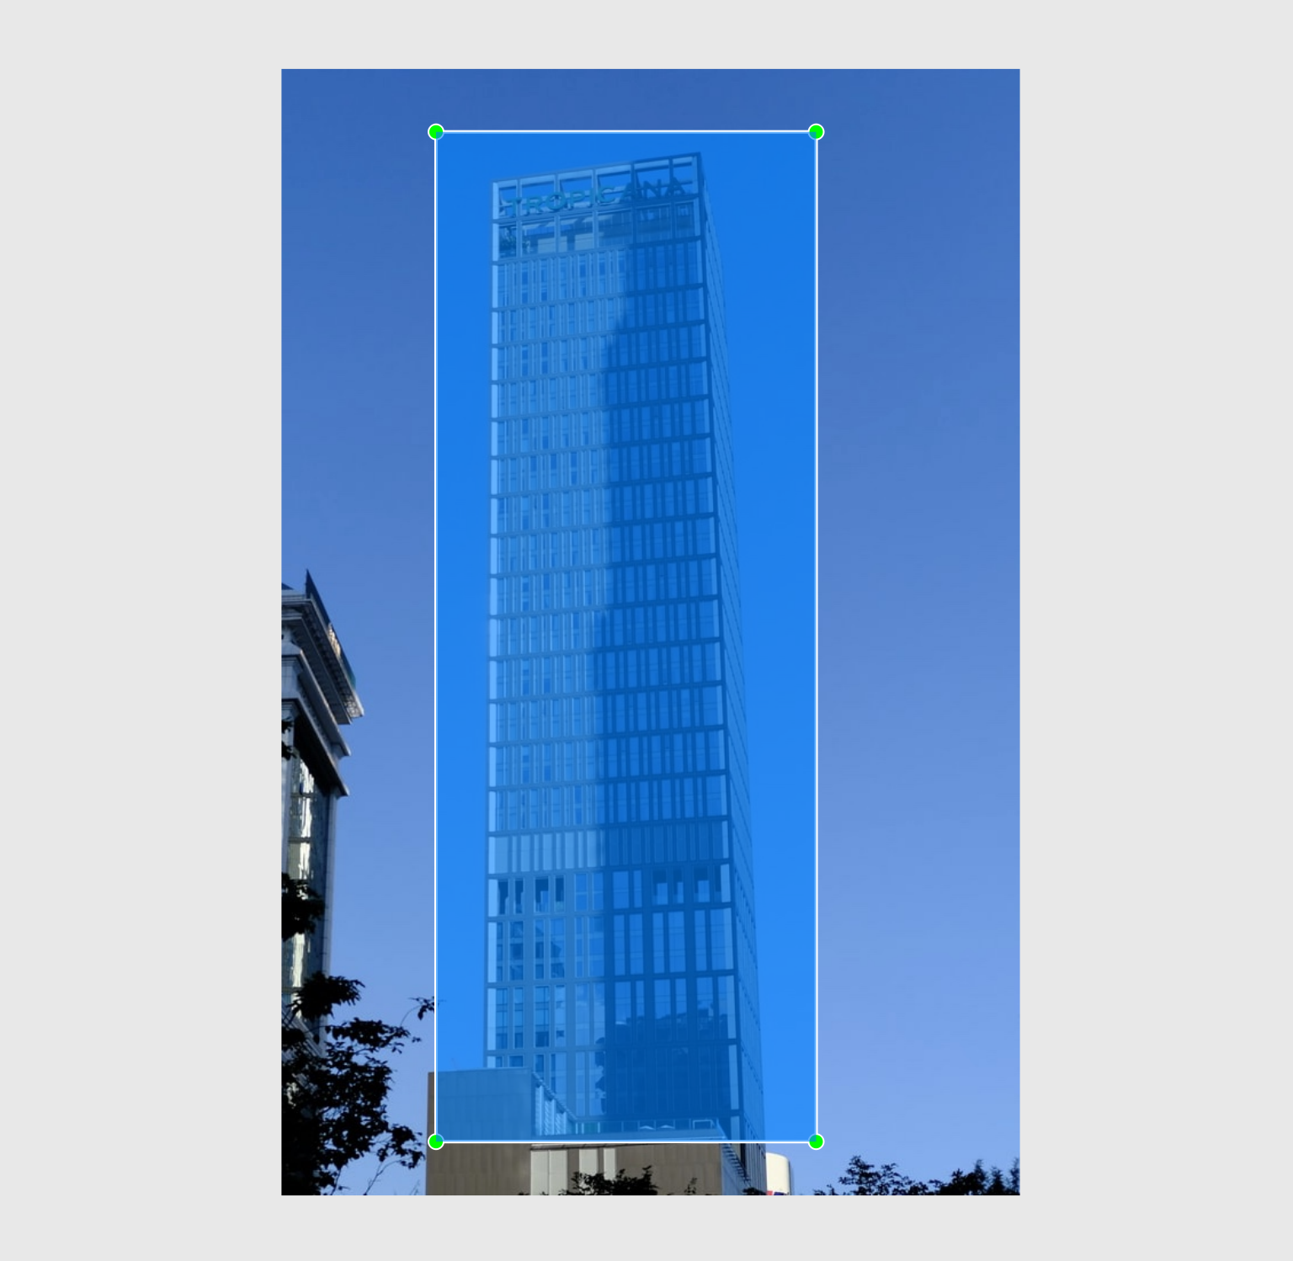
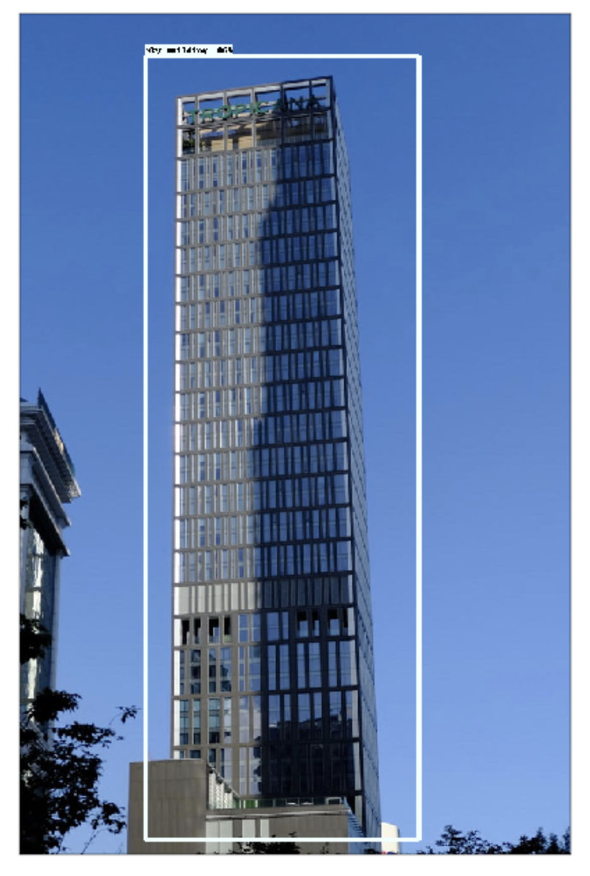
Detection Analysis
Ground Truth
Predicted bounding box

Slide 35
Progress
Dataset Collection and labeling
Image preprocessing
Image classification using CNN
Image classification using transfer learning MobileNet v2
Object detection using MobileNet –SSD

Slide 36
Challenges
Collection of datasets
Improve the accuracy of the classification model
Improve the object detector reduce the detect errors
Developed object detection in real time

Slide 37
Conclusion
More data is required for trained the model
CNN performs better for image classification
Transfer learning is more efficient rather than CNN for image classification
Hyperparameter tuning is required for higher accuracy
Object detection using MobileNet and SSD perform well

Slide 38
References
Jawadul H. Bappy, Joseph R. Barr, Narayanan Srinivasan, Amit K. Roy-Chowdhury. Real Estate Image Classification, IEEE Winter Conference on Application of Computer Vision (WACA), 2017
Omid Pouraseed, Tomas Matera, Serge Belongie. Vision based Real Estate Price Estimation, arXiv: 1707.05489v3, 2018
M. Vakalopulo, K.Karantzalos, N. Komodakis, N.Paragios. Building Detection in Very High Resolution Multispectral Data with Deep learning Features, IGARSS,2015
Neha Sharma, Vibhor Jain, Anju Mishra. An Analysis of Convolutional Neural Networks For Image Classification, International Conference on Computational Intelligence and Data Science, 2018
A. Younis, L. Shixin, S. JN, Z. Hai. Real Time Object Detection Using Pre-trained Deep Learning Models MobileNets-SSD, ICCDE,2020

Slide 39
Thank You

